Slide 1
Moving Freight Safely and Efficiently
Wisconsin Department of Transportation Secretary Mark Gottlieb
Milwaukee Logistics Council
November 13, 2014
Notes:
Thanks to Steve Rose (President, Milwaukee Logistics Council), Kurt Baumann (Chairman of the Board, Milwaukee Logistics Council), Brian Randleman (with Rockwell Automation) and all the Milwaukee Logistics Council members.
Audience: Logistics professionals (including freight carriers, sales reps., manufacturing & retail transportation professionals) and students (Marquette University students).
Thanks to all of you for your hard work supporting freight and economic growth in Milwaukee and throughout Wisconsin.
At Wisconsin DOT, our transportation system and the role it plays in the economy is very important.

Slide 2
Overview of presentation
Governor/WisDOT commitment to freight
Freight Planning
Freight Operations
Freight Opportunities
Looking ahead
Notes:
Over the next few minutes:
Talk about our state’s commitment to freight. Starts with Gov. Walker, extends through our entire department.
Provide an overview of the WI multimodal freight network and the planning efforts underway.
Specific steps WI is taking in working with other states from an operations perspective.
Highlight various freight opportunities/assistance programs (TEA grants, STP Freight, HAP, etc.).
Conclude with emerging issues (e.g. truck parking constraints) how to address them.

Slide 3
Commitment to Freight
Governor’s Fourth Annual Freight Industry Summit
August 14, 2014 in Appleton, WI
Annual WisDOT Fall Freight Rail Conference
Nov. 12, 2014 in Madison, WI
Creating a “freight-friendly” Wisconsin
Understanding business needs
Notes:
Governor Walker has made freight transportation a top priority.
One way we’re strengthening partnerships is through the Governor’s Freight Industry Summit. Gathers public and private officials with a common interest in all forms of freight movement. Fourth annual summit was held in August 2014 in Appleton.
This year’s summit focused on factors that influence business site selection; challenges related to the overall supply chain and steps we’re taking with industry to address that.
For many years, WisDOT has sponsored a Fall Freight Rail Conference where we talk directly with freight rail providers. This year’s event was held yesterday (November 12).
Goal of all these efforts: create what Governor Walker has called “a more freight-friendly Wisconsin.”
This means a better understanding of business needs, demands being place on shippers, working with private industry and policymakers on laws/rule changes that keep our freight system and economy moving forward.

Slide 4
Freight Advisory Committee
MAP-21encourages states to establish a freight advisory committee composed of a representative cross-section of public- and private-sector freight stakeholders
Governor Walker announced the development of a Freight Advisory Committee at the 2014 Freight Summit
1st meeting will occur in early 2015
Notes:
The Moving Ahead for Progress in the 21st Century Act (MAP-21) includes a number of provisions to improve the condition and performance of the national freight network and support investment in freight-related projects.
MAP-21 encourages states to establish a freight advisory committee with a cross-section of public/private freight stakeholders. MAP-21 also encourages each state Freight Advisory Committee to develop a comprehensive plan for its immediate and long-range freight-related planning and investment.
Gov. Walker announced creation of the Wisconsin Freight Advisory Committee at the August summit. The Committee will be comprised of freight industry executives/leaders who will provide input for freight policies and solutions in Wisconsin. The Committee will meet at least twice per year – first meeting next year.
The Committee’s work will build upon Connections 2030 – WisDOT’s long-range transportation plan that addresses all forms of transportation over a 20-year period.

Slide 5
Multimodal Freight Network
Composed of highways, local roads, rail lines, ports and airports
The network will help prioritize Wisconsin’s freight transportation improvement activities
Notes:
The Wisconsin Department of Transportation's Multimodal Freight Network is composed of highways, local roads, rail lines, ports and airports.
The network identifies the role of the different transportation facilities in shipping freight to and from Wisconsin. The network will help prioritize Wisconsin's freight transportation improvement activities in the future.
The Multimodal Freight Network builds upon the department's previously-established priorities for highways, railroads, airports and water ports - as articulated in “Connections 2030” plan.

Slide 6
Strategic Highway Research Program
WisDOT received a Strategic Highway Research Program (SHRP 2) proof of concept pilot award
The project will develop a new freight model tool to support freight planning and freight-related project analysis
Notes:
Department has received an award through the Strategic Highway Research Program. Goal is to develop a freight model tool to support freight planning/analysis.
The tool will be used to reflect multimodal freight industry supply chain practices at the statewide and local levels. Transportation planners and engineers will utilize the tool for scenario planning or to perform sensitivity tests for policy-related questions.
A Freight Model Study Committee will be organized and charged with discussing and offering technical assistance on freight issues and data. This research will also serve as an example for other states and metropolitan planning organizations to better model and analyze freight data.

Slide 7
Modal Considerations
Notes:
WisDOT established a statewide OSOW Freight Network for use by permitted oversize/overweight vehicles. The routes are based on OSOW traffic frequency data on high and wide roadway roadways along the state system.
The statewide OSOW Freight Network is a subset of “Designated Long Truck Routes” i.e., all roads on the Freight Network are on “Designated Long Truck Routes” with the exception of a few roadways that may be an origination point or a recurring destination point, such as a manufacturing plant or a gravel pit.
A brief look at the Wisconsin Freight Rail Network….There are 13 freight railroads that operates on about 3,300 miles of track. Currently, about 530 miles of state-owned track. We are in the process of acquiring another 70 miles to the state-owned system in the corridor between Madison and Reedsburg. That makes the new total about 600 miles of state-owned track.

Slide 8
Transportation System Improvements
Harmonization efforts with neighboring states
Division of State Patrol has conducted 30,000 inspections
Weigh-in-motion and WinnDOT portal considerations
511 system freight enhancements
WisDOT staffing of freight specific positions
Notes:
Along with planning efforts, WisDOT has moved forward with a variety of operational improvements. This includes various regional and national efforts aimed at enhancing harmonization efforts between neighboring states. These efforts range from permitting to truck parking to corridor mitigation.
Weigh-in-Motion technology has reduced the amount of inspections. Not only that, but streamlined permitting between Minnesota and Wisconsin (WinnDOT) has assisted in permitting efficiency.
There have been freight enhancements made to the 511 system. These new enhancements will provide drivers with additional real-time information.
Freight-specific positions have been established or designated freight tasks have been aligned with region and central office staff who are charged specifically with enhancing freight flow. These recent staffing changes have assisted with the enhancement of freight flow (shipping efficiency), traffic safety, congestion reduction, economic growth, and infrastructure preservation. A freight engineer position in the central office assists with oversize/overweight mega loads (next slide shows an example).

Slide 9
Transportation System Improvements
WisDOT has identified known freight impediments and developed a phased mitigation plan to eliminate freight constraints and bottlenecks
Will commence in Spring 2015
Notes:
Operational improvements include modifications to highway system to accommodate larger vehicles.
The image illustrates an example intersection mitigation (in accordance with WisDOT’s Facilities Development Manual or FDM). The FDM has been updated over the past couple of years to accommodate larger oversize and overweight (OSOW) vehicles (e.g. wind towers).
Along with identifying freight impediments, we’re implementing a phased plan to address/eliminate these constraints next year.

Slide 10
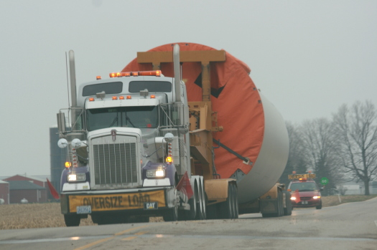
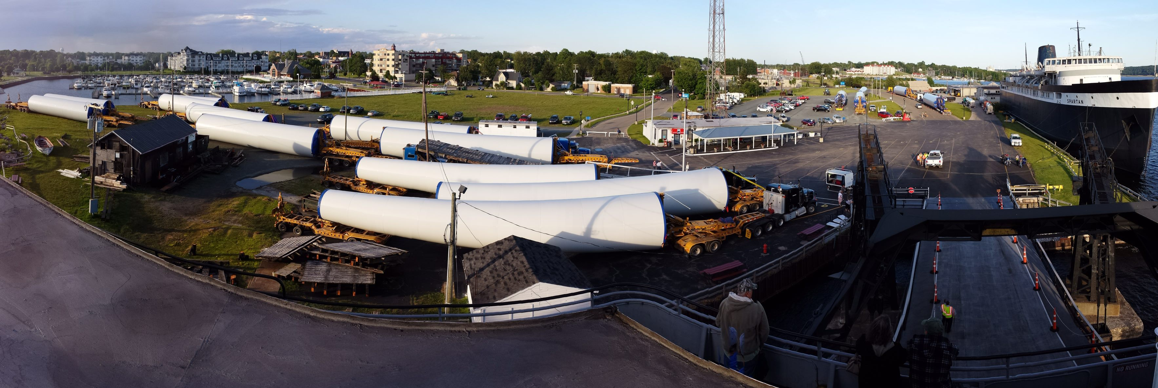
Wind Industry – System Improvements
Initiated several system improvements to facilitate wind tower shipments
WisDOT formed collaborative efforts with the city of Manitowoc and Broadwind Energy, Inc. to resolve impediments facing the wind tower industry
Notes:
Operational improvements include working closely with the wind tower industry – understanding and addressing their concerns.
For example, worked closely with city of Manitowoc and Broadwind to address route impediments.

Slide 11
Wind Industry – System Improvements
2014 Wind Tower Statistics:
12 wind tower sections moved from Manitowoc, WI to IA per week
16 wind tower sections moved from Manitowoc, WI to MN (destined for ND) per week
Keys to Success:
Enhanced communication and collaborative outreach
To date, no preventative incidents have occurred
Close coordination with neighboring states assisted in facilitating seamless transit of wind towers throughout the Midwest
Notes:
Here’s a little more info on the volume of wind tower components moving through WI. Following this outreach effort, no traffic incidents of significance. Continue working closely with neighboring states.

Slide 12
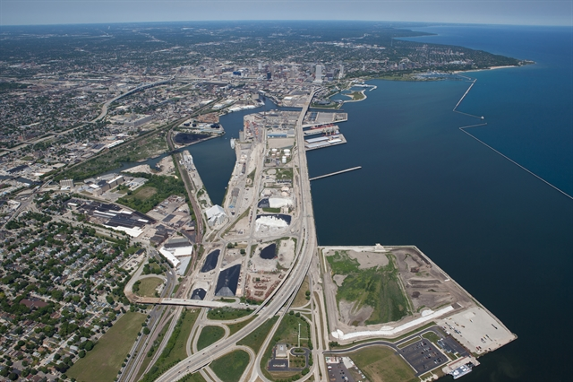
Port of Milwaukee – System Improvements
Collaborative efforts with the Port of Milwaukee, City of Milwaukee Engineering Section and various other local jurisdictions assisted in improving port access for OSOW loads
Notes:
Closer to home…worked with the port and city of Milwaukee on efforts to improve port access for oversize/overweight loads.

Slide 13
Trans 254/255 Changes
Notes:
Recently implemented Trans 254/255 administrative rule changes that expand freight operating windows and load sizes.
The proposed revisions to Trans 254 and Trans 255:
increase the hours oversize vehicles may operate on state highways
relax route limitations to reflect improvements to the Milwaukee County Expressway System
eliminate outdated requirements based on federal laws that have been repealed
update permit application provisions to reflect current practices

Slide 14
Trans 254/255 Changes
Notes:
From slide…(changes for larger, oversized vehicles).

Slide 15
Trans 254/255 Changes
Notes:
Milwaukee County Expressway restrictions…

Slide 16
OSOW Mega Load – Totran
Load dimensions:
Length: 260’09”
Width: 20’01”
Height: 16’00”
Weight: 507,000 lbs
Route:
West Allis, WI to MN
Trip duration:
Five days and five nights
Only allowed to travel at night
Escorts
Four State Patrol escorts and two private escorts

Slide 17
Freight Opportunities
Transportation Economic Assistance Program (TEA)
Freight Railroad Preservation Program (FRPP)
Freight Railroad Infrastructure Improvement Program (FRIIP)
Harbor Assistance Program (HAP)
Surface Transportation Program – Freight (STP – Freight)
Notes:
Want to highlight several programs WisDOT oversees to help fund improvements to multimodal freight system
Includes…(from slide).
These should be thought of as “economic development” and “local assistance” programs designed to improve and preserve freight infrastructure.
These programs are administered in close cooperation with private railroads, businesses and communities.

Slide 18
Transportation Economic Assistance Program
TEA grants cover up to 50 percent of costs for road, rail, harbor and airport projects that:
Help attract new employers to Wisconsin
Retain existing businesses
Expand new or existing business facilities
Since 1987, $95 million in TEA grants for 338 projects, creating or retaining over 83,000 jobs
Notes:
Transportation Economic Assistance or TEA program is Wisconsin DOT’s main economic development program that can fund a variety of transportation improvements that directly support job creation/retention. Everything from new roads/streets to rail sidings.
Again, projects must help retain and/or expand jobs.
Grants cover up to 50% of project cost. Requires local sponsor share.
Since 1987, some $95 million in TEA grants for 338 projects creating/retaining over 83,000 jobs.

Slide 19
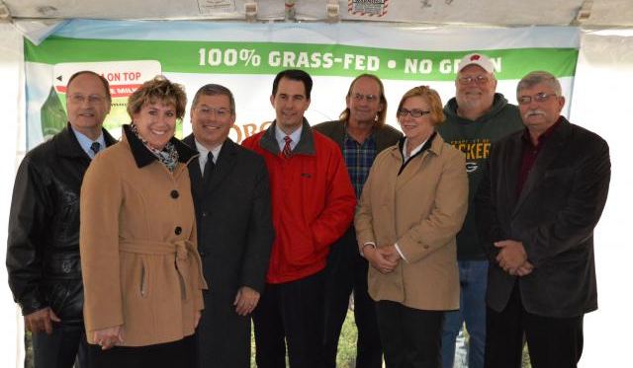
Transportation Economic Assistance Program
A September 2007 job audit reveals that actual job creation and retention is 6.3% above that promised
The state average cost to-date has been $2,577 per direct job created and retained
Notes:
October of 2013, $1.4 million TEA award to Organic Valley in Cashton. Created about 200 additional jobs.

Slide 20
Freight Rail Preservation Program
FRPP grants help preserve rail service and can cover up to:
100 percent of land acquisition costs
80 percent of improvement acquisition costs, rehabilitation or construction costs
Funded through state bonding
Notes:
FRPP is a grant program that can be used to:
Purchase abandoned rail lines in an effort to continue freight service
Preserve opportunity for future rail service
Rehabilitate facilities, such as tracks or bridges, on publicly-owned rail lines

Slide 21
Freight Rail Preservation Program
Since 1980, about $175 million in FRPP grants awarded for over 75 rail acquisition/rehabilitation projects
Budget: $52 million in bonding for 2013-15 state budget
Local involvement crucial
Notes:
Since 1980, FRPP has helped fund over 75 projects for around $175 million dollars.
2013 – 15 state budget includes $52 million in bonding authority to fund the program.
Local involvement is critical to the success of the program.

Slide 22
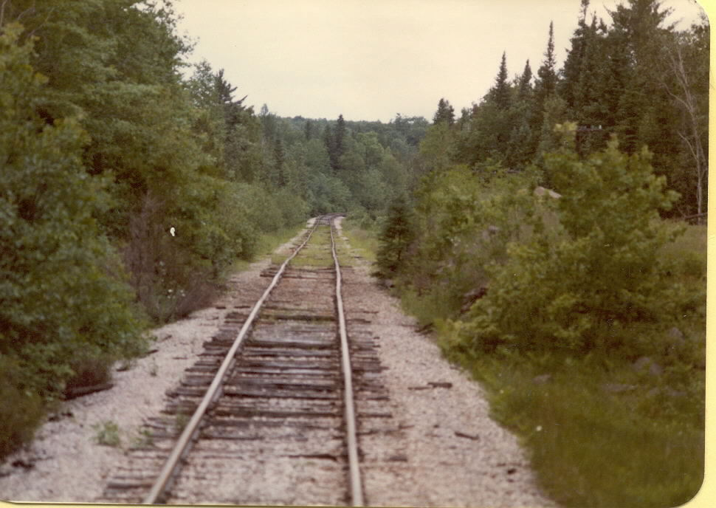
Notes:
Good example of a line needing rehab

Slide 23
Notes:
Line rehabilitated with welded rail
(FYI - these last two photos are “unrelated” meaning they are NOT “before” and “after” shots, but are meant to illustrate a line that needs rehab and a line that has undergone improvements).

Slide 24
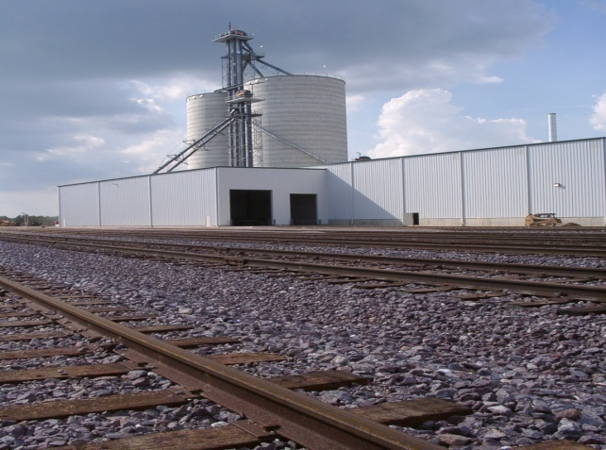
Freight Rail Infrastructure Improvement Program
FRIIP loans are designed to improve rail service and can cover up to 100 percent of project costs to:
Connect an industry to the national rail system
Enhance efficiency, safety, intermodal movement
Line rehabilitation
Strengthen the economy
Notes:
Freight Rail Infrastructure Improvement Program is a revolving loan program. It can cover up to 100 percent of costs for rail improvements that:
Connect a business to the national rail system
Support the safe, efficient and intermodal movement of freight
Rehabilitate rail lines
Common denominator: projects that support economic growth.

Slide 25
Freight Rail Infrastructure Improvement Program
FRIIP low-interest loans repaid within 10 years
Since 1992, $119 million in FRIIP loans for about 100 projects
Budget: about $5.5 million annually based on repayment of prior loans
Notes:
FRIIP provides low interest loans that must be repaid within 10 years.
Has provided about $119 million in loans for about 100 projects.
Budget: about $5.5 million annually.

Slide 26
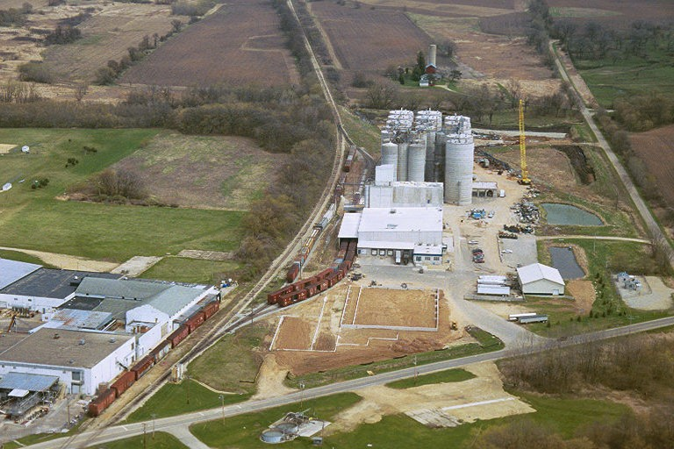
Didion Milling, near Cambria, WI
Notes:
This is a photo of Didion Milling near Cambria, Wisconsin, which benefitted from FRIIP.
Funds similar projects such as:
Rail sidings, passing tracks and crossings
Grain loading and storage facilities
Fertilizer unloading and storage facilities
Warehouses
Log and lumber loading and storage facilities

Slide 27
Harbor Assistance Program
Assists harbor communities along the Great Lakes and Mississippi River in maintaining and improving waterborne commerce
Port projects typically include dock reconstruction, mooring structure replacement, dredging, and the construction of facilities to hold dredged material
Notes:
To be eligible for funding:
The project must benefit facilities that are used for cargo transfer, ship building, commercial fishing or regular ferry service
The applicant must be a local unit of government or a private owner of a harbor facility
The project must pass a rigorous benefit-cost analysis
The project must have been identified in a current Three-Year Harbor Development Plan.

Slide 28
Surface Transportation Program -Freight
STP-Freight allocates federal funds over two years to complete projects that improve freight connections
Governor Walker announced STP-Freight Pilot on September 17, 2013
Seven projects totaling $9.5 million approved
First project completed in Baraboo – ribbon cutting today
Notes:
STP-Freight is a new pilot initiative that grew out of the Governor’s Second Annual Freight Summit.
STP-Freight rating criteria focused on projects associated with multimodal and intermodal facilities, warehousing and distribution centers, projects that improve local freight connections to the state highway network and projects that provide many-to-one and one-to-many connections. Projects that were able to be completed quickly (preferably within two years) received priority in the rating process.
Sept. of 2013, Governor announced approval of seven STP Freight awards totaling 9.5 million
WisDOT Deputy Sec. Mike Berg in Baraboo today to celebrate completion of first STP Freight project (reconstruction of about 1-mile of South Boulevard in Baraboo – a key economic artery that serves several major employers such as Sysco, Seneca, Farm and Fleet)

Slide 29
Highway and Bridge Investments
WisDOT annually invests approximately $1 billion in 350 highway and bridge projects
Notes:
Along with investments in water ports, railroads, airports, WisDOT oversees about 350 state highway and bridge improvement projects around the state each year representing about $1 billion.

Slide 30
Looking Ahead
Continue building partnerships
MAPSS emphasis
Specific measures to track reliability and delay
Notes:
What’s ahead? Freight summits other initiatives have greatly strengthened our relationship with private industry and understanding of barriers/challenges. Through efforts like Freight Advisory Committee, we will work to continue building that partnership.
Within WisDOT, we continue to analyze current policies/practices seeking to find ways to deliver services more efficiently. That’s what MAPSS is all about. Sets goals/tracks progress in key areas of Mobility, Accountability, Preservation, Safety and Service.
Recently-added MAPSS measures look at travel reliability and hours of delay. Helps us identify bottlenecks and communicate with the public.

Slide 31
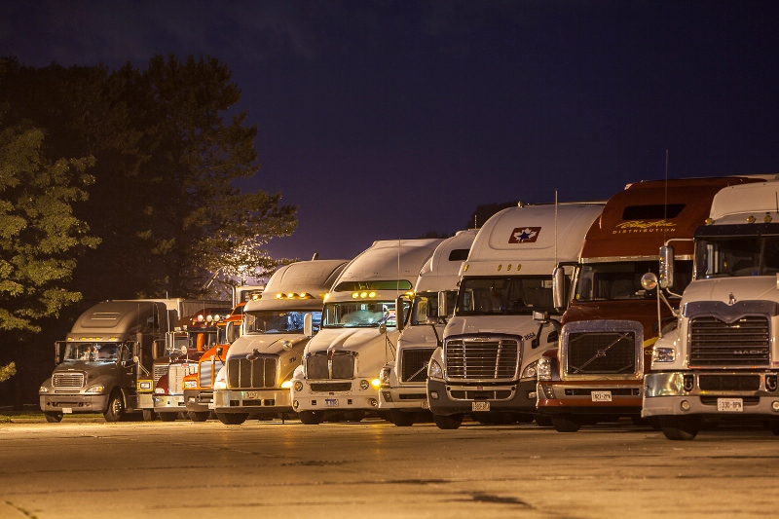
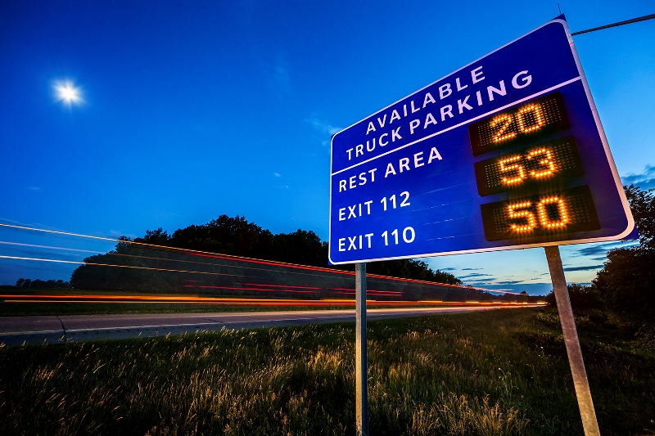
Looking Ahead
Safe, adequate parking
Inventory of current parking at rest areas/SWEFs
FHWA $1 million grant pilot
Notes:
We all know adequate truck parking is an ongoing challenge. As economy/trucking industry strengthens, combined with recent federal rules (Hours of Service), it puts additional emphasis on providing safe, adequate, accessible truck parking.
Photo on left illustrates truck parking constraints at rest areas and other facilities in WI. Many states are implementing new technologies to assist in alleviating truck parking constraints. In Michigan (image on the right) has recently implemented a program providing drivers with real-time truck parking availability at rest areas and other public facilities along the heavily traveled I-94 corridor.
Here in WI: we’re working to inventory truck parking availability at state-owned rest areas and weigh stations (Safety and Weight Enforcement Facilities).
WI received a $1 million grant from FHWA to develop a real-time ITS truck parking program (similar to efforts in Minnesota and Michigan). Wisconsin’s program is harmonized with other states and will assist in alleviating some truck parking constraints in Wisconsin. Hope to begin implementation in WI next year.

Slide 32
In Conclusion…
Shared interest in safe, efficient operations
Common interest in freight and our ability to operate, grow and succeed
Freight is vital to the economic climate in Milwaukee and throughout Wisconsin
Notes:
To wrap up, we all have common interests/goals: safe, efficient operations; supporting your ability to operate, succeed, and grow the economy.
From Governor Walker, through our entire department, we recognize the important role freight plays in all these areas. We’re especially thankful for our partners in the private sector. We need your help/cooperation to succeed – to continue development of a more “freight friendly WI.”
Thanks for inviting me and for all you do!

